Slide 1


SAP UI5 & FIORI with OData TRAINING using BAS
Anubhav Oberoy
Day – 9

Slide 2

Agenda – Day 9
Creating model in Manifest.json
Search Functionality
List Modes and Grouping
Header and Footer Toolbar
Worklist Application
Split App Container
Loading Empty view at Start
Performance Issues in our app
Introduction to Router
Routing Configuration
Route Match Handler
Icon Tab Bar
Responsive Table (sap.m.Table)

Slide 3
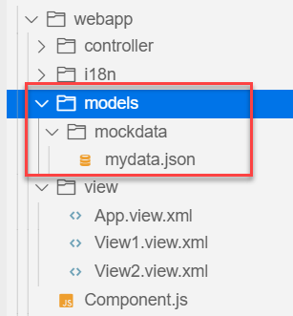
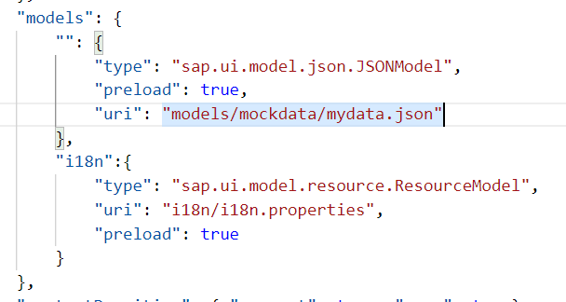
Hands – on: Models in manifest.json
Now we want to bind our list control to a model to show the multiple records using the list control.
For this first we need a file with some demo data related to the fruits, so we have created a file which has three entity sets:
fruits – name, color, type (neutral, citrus, alkaline),price, healthBenefit, unit, status (available, discontinued, out of stock), image (url from google) – 20
cities – name, state, famousFor, population – 10
supplier – name, city, country, contactPerson, phone, email, sinceWhen – 10
Now we will create a models folder in the webapp and in the models folder we will create a folder named mockdata, we will put our json file in this folder.
Code Link:
manifest.json
mydata.json
View1.view.xml

Slide 4
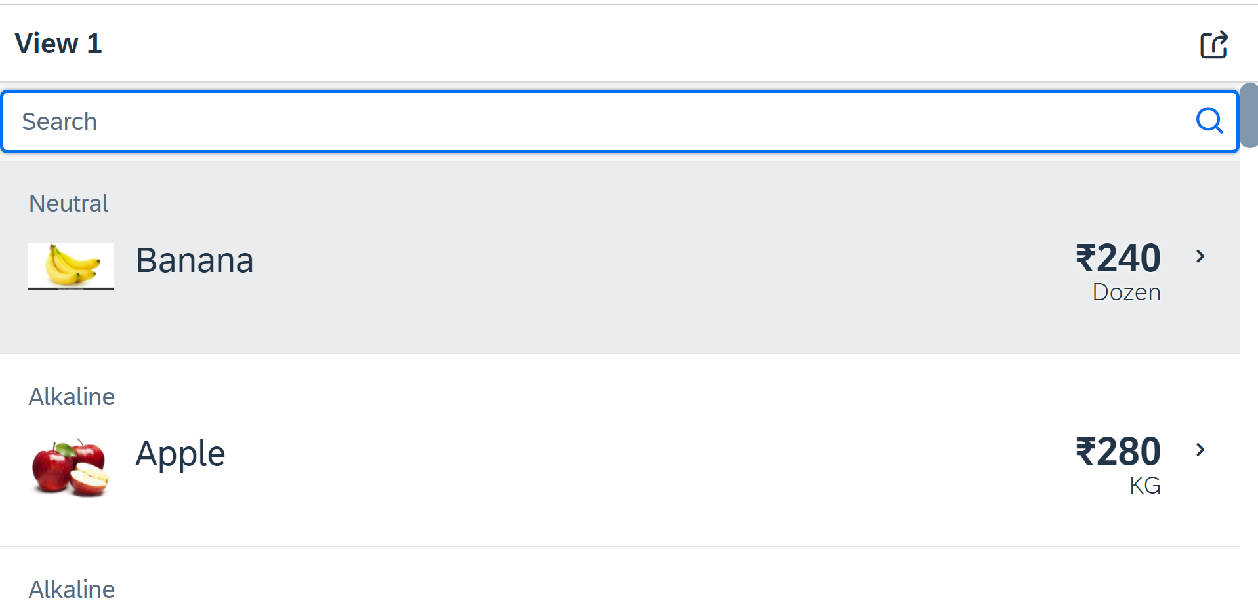
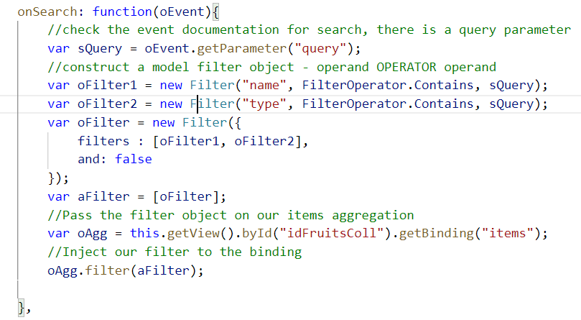
Hands – on: Search Functionality
Nowadays we come across many web pages that provide data in the form of lists or tables. These lists are enabled with search functionality, i.e., as the user types in into the search field and press enter then the data in the list is filtered according to the value in search field.
Code Link:
View1.view.xml
View1.controller.js

Slide 5
List Modes
The mode property defines the appearance of the left area of a list item.
Lists have properties and events and they contain list items that inherit from sap.m.ListItemBase, which provides navigation, selection and event features.
Delete
SingleSelect
01
04
only one list item can be deleted via provided delete button
Right-positioned single selection mode (only one list item can be selected).
01
04
MultiSelect
You can edit this text
SingleSelectLeft
02
05
02
more than one list item can be selected
05
Left-positioned single selection mode (only one list item can be selected).
03
06
None
03
06
SingleSelectMaster
no selection
Selected item is highlighted but no selection control is visible (only one list item can be selected).

Slide 6
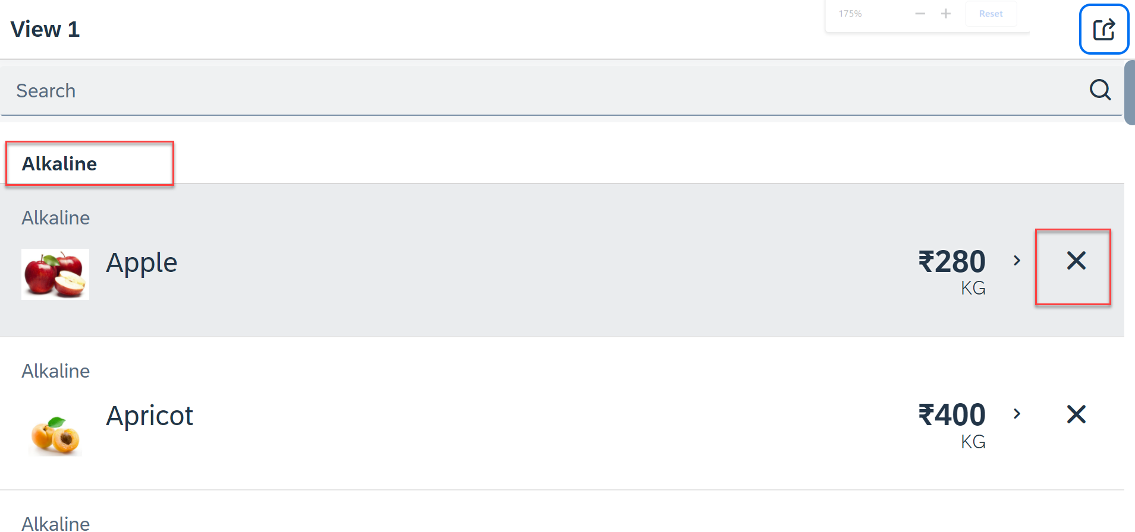
Hands – on: List modes and Grouping
Now we will look at the different type of List mode provided by the UI5.
Along with that we will Implement the Press event, Selection change and Delete Event in the List Control.
Also we will Group the data according to the type of Fruit.
Code Link:
View1.view.xml
View1.controller.js

Slide 7
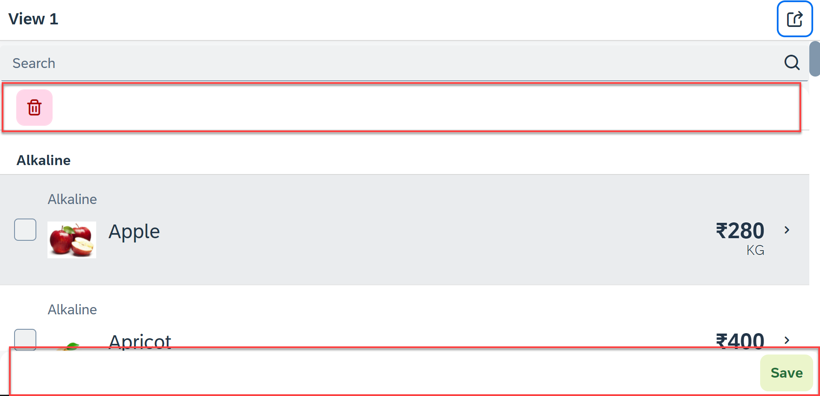
Hands – on: Header and Footer Toolbar
Now we will add a Header Toolbar to the list control and in that we will add a delete button to delete multiple items from the List.
We will also add a Footer toolbar to the page control and in that we will add a save button on press of the save button a alert will be shown to the user.
Code Link:
View1.view.xml
View1.controller.js

Slide 8
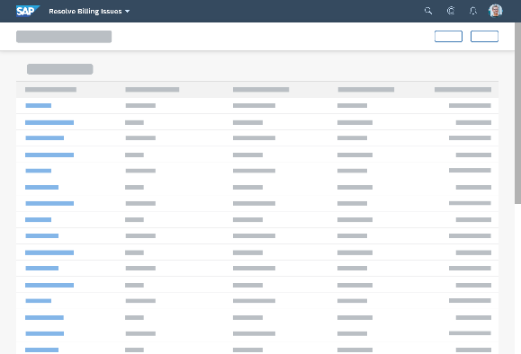
Introduction to Worklist Application
A worklist displays a collection of items a user needs to process. Working through the list usually involves reviewing details of the items and taking action. In most cases, the user has to either complete a work item or delegate it.
When to use:
Users have numerous work items and need to decide which ones to process first.
You want to give users a direct entry point for taking action on work items.
Users need to work with multiple views of the same content (for example, items that are “Open”, “In Process”, or “Completed”). You want to offer tabs for switching between views.
Detail View
List Page

Slide 9
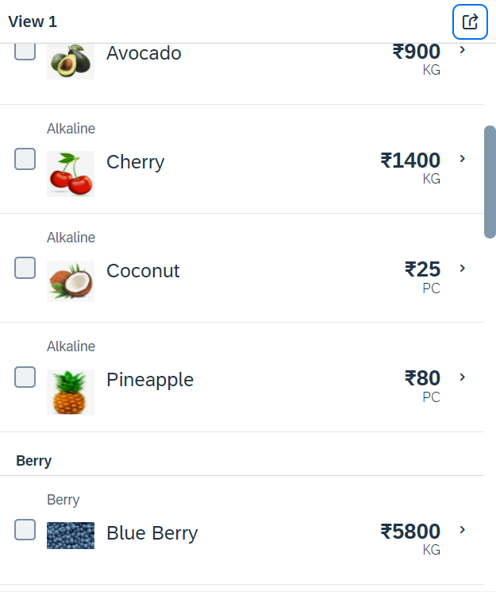
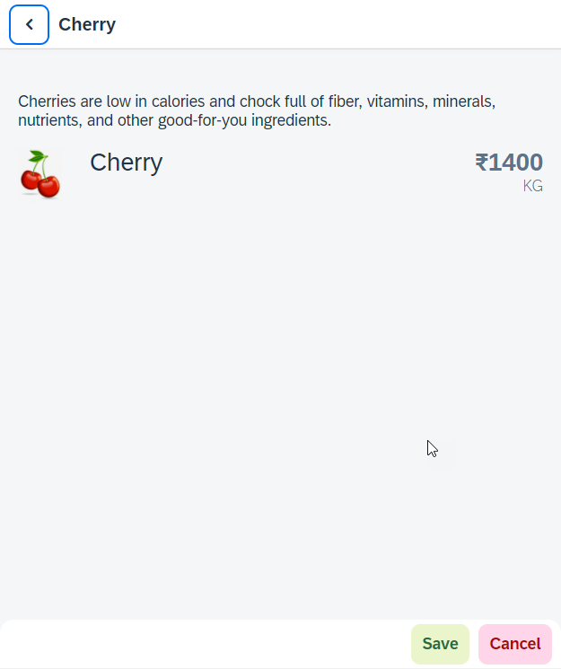
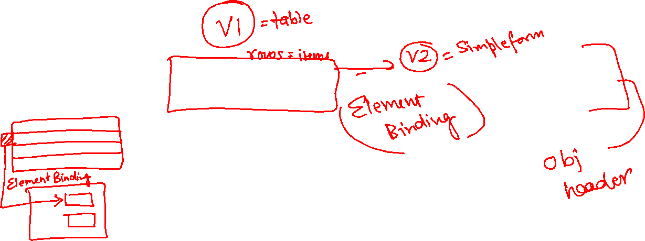
Hands – on: Worklist App
Now we will make our application a worklist app. On selecting the fruit on the View1 navigate to the View2 and show the details of that the selected fruit on it.
For this we have to modify the onSelectItem Function to get the path of the selected item and pass it in the onNext function.
Code Link:
View1.view.xml
View1.controller.js
View2.view.xml

Slide 10
SplitApp Container Control
A split app container control will divide our app into 2 parts, 1st is called master section and 2nd is called detail section. It is used to fully optimize the screen width for desktop apps.
SplitApp Container
masterPages
detailPages
App Container
View1
View2
View1
View2

Slide 11
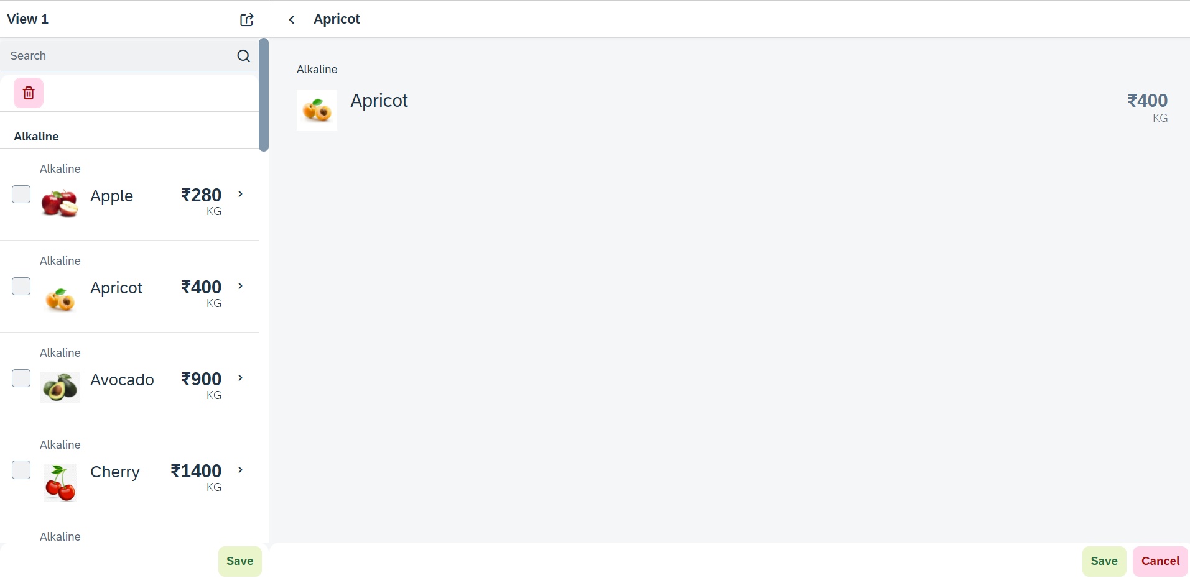
Hands – on: SplitApp (Mater Detail App)
Now we will convert our worklist app to a master detail application.
Once we change the app container, we have to change the method of getting the view object in onNext function.
Code Links:
App.view.xml
Component.js
View1.controller.js

Slide 12
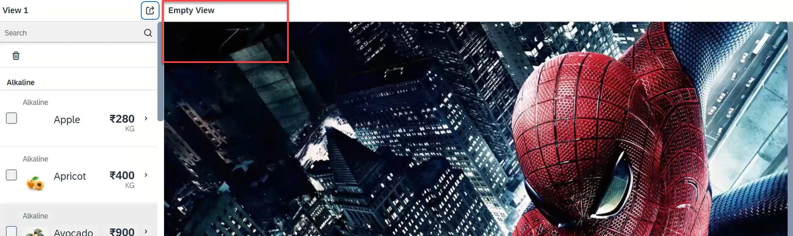
Hands – on: Empty View at start
Now we want to load an Empty view in the detail section when our application starts.
To do this first we need to create one Empty View and Empty controller.
After we need to add the Empty view to the Split App container in the Component.js file.
oAppCon.addMasterPage(oView1).addDetailPage(oEmpty).addDetailPage(oView2);
Code Link:
Empty.view.xml
Empty.controller.js
Component.js
View1.controller.js
This view will be loaded by default

Slide 13
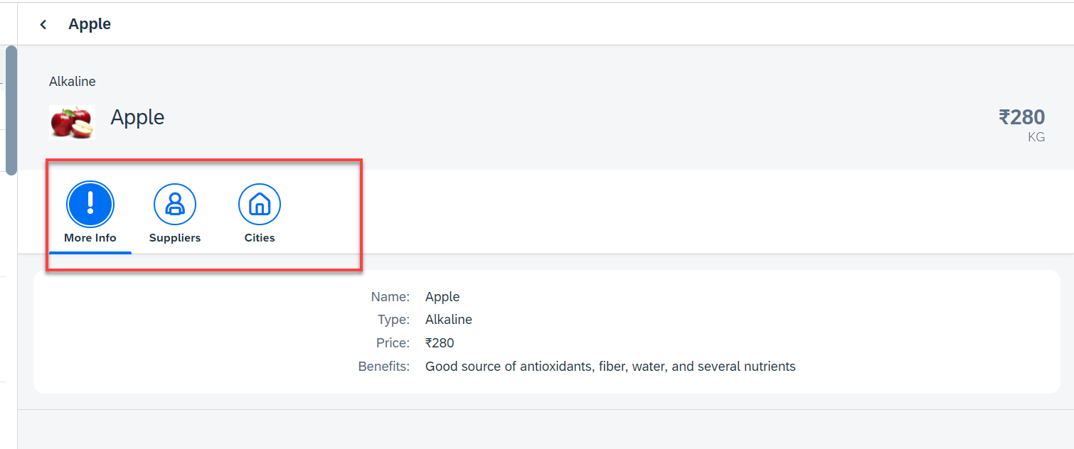
Hands – on: Icon Tab Bar
Now in the View2, we will create a icon tab bar to show the additional data related to the fruits, like Supplier and City data.
For now in the first section we will add a simple form to show the data of fruit.
Code Link:
View2.view.xml

Slide 14
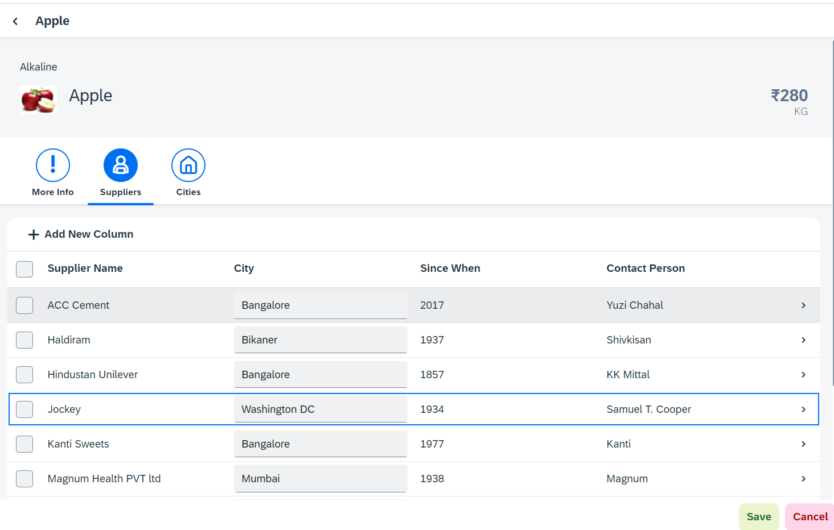
Hands – on: Sap.m.Table (Responsive Table)
Now in the second section of the icon tab filter bar we will add a Responsive table containing the Supplier Data.
Along with that we will add a button in the Header of the table to add a new column.
And on select of a row in the table the table path will be shown in alert message.
Code Link:-
View2.view.xml
View2.controller.js

Slide 15

Performance Issues in our Fiori App
We have used sap.ui.view API to create the object of the view, but it seems that the API is obsolete. Then what is the right way to instantiate our view?
All the view objects are instantiated when app starts, whether we want or not. If user does not navigate to a view, still the view object is getting created. This is a misuse of computation power and slow down our app when number of views are increased/high.
For each view, we are writing more and more code to create object, multiple developers will add this code in different place, because of this the maintenance will be come very expensive even the handover will be very hard.
The browser navigation button (back) is not working properly.
When the refresh of app happens, the application should restore the state of the UI. It should not start all over again. So user will not frustrate applying all the filters again.
When we take a URL of the page and share with colleagues/friends/family, when they open same URL, Eventually they should see the same state of application what I see. Basically we should restore the state of UI as it is in our system.
Router

Slide 16
Router
Router is an object which is provided by SAP UI5 Component (UIComponent).
It is responsible for creating our view objects on demand.
It is also responsible for complete app navigation based on pattern (end point, hash tag).
How to use router:
Get the router object form the UIComponent class.
Call initialize method using the object
The initialize method will SCAN manifest.json to find the routing configuration (mandatory).
Add the routing configuration in manifest.json
rootView – base view we want to load
config – base configuration like view type, path of all views etc.
routes – array of all the targets, patterns and route names
targets – put all the end point target with views which needs to be instantiated and nav.
Sap.m.routing.Router is the class used for Routing and Navigation purpose in SAP UI5 framework.
“Pattern” defines the hashtag that needs to be added at the end of the URL when it is hit.
“name” defines a unique name for the particular route.
“target” defines the target which is defined in targets section

Slide 17
Routing Configuration
Routing Configuration is defined in manifest.json file. It is defined under the “sap.ui5” section.
Routing configuration consists of routes, targets, config, and owner.
rootView
config
routes
targets
This section contains the information about our Root View. The View which works as a container for other views. In this section we provide the path of the view, type and controlId.
This section contains the global router configuration and default values that apply for all routes and targets. We define the router class that we want to use and where our views are located in the app.
Each route defines a name, a pattern, and one or more targets to navigate to when the route has been hit.
Three subsections :-
1. pattern
2. name
3. target
A target defines a view that is or more routes displayed, it is associated with one.
Subsections: -
Overview
detail

Slide 18
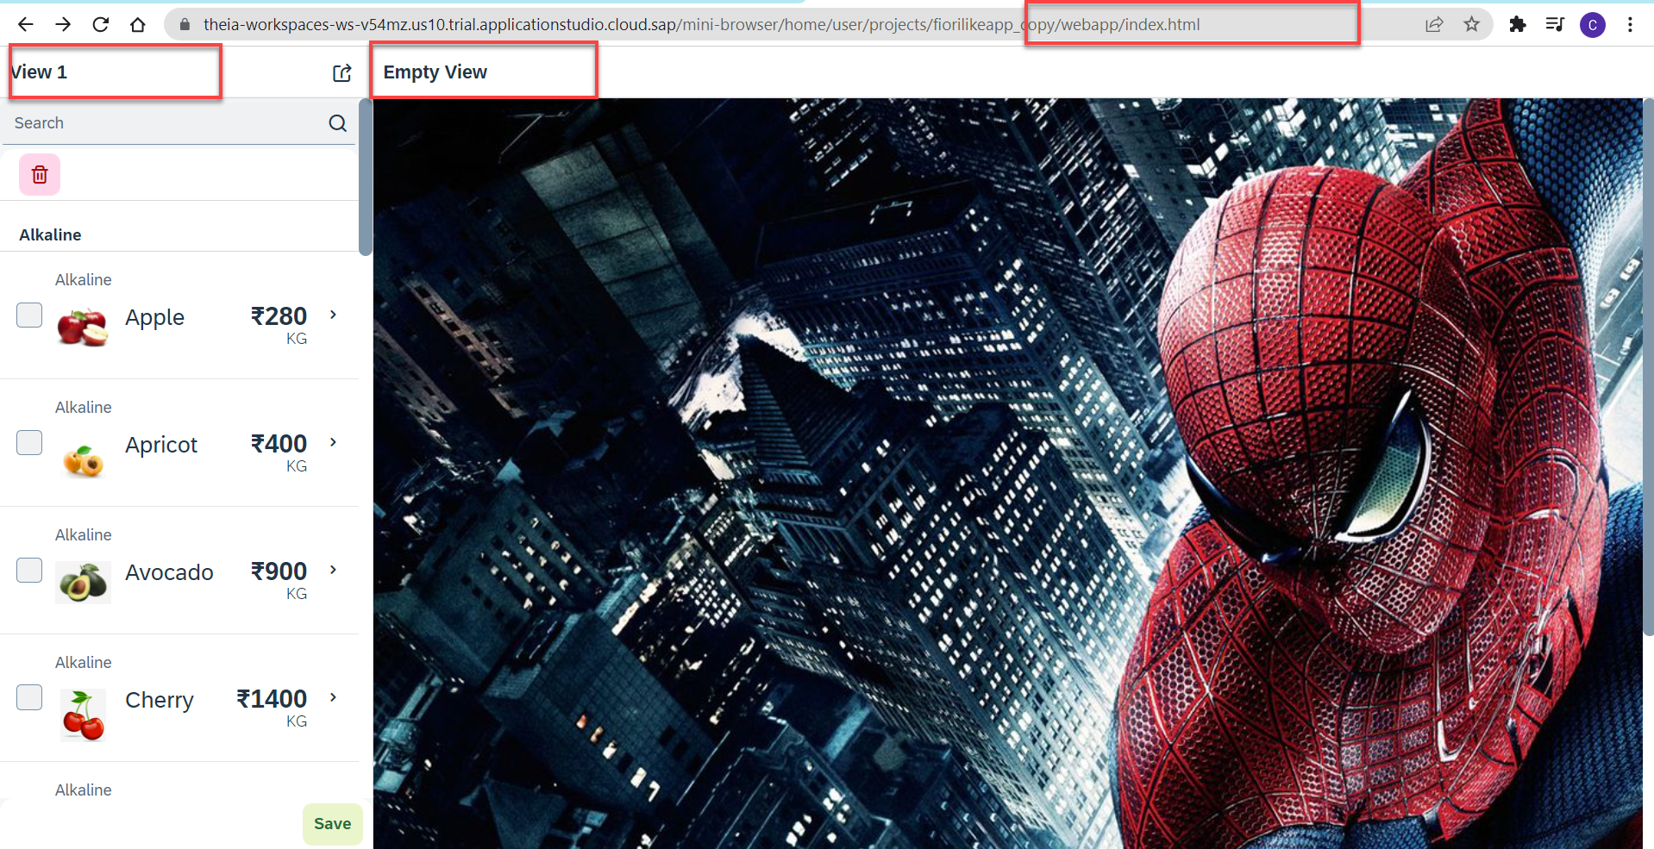
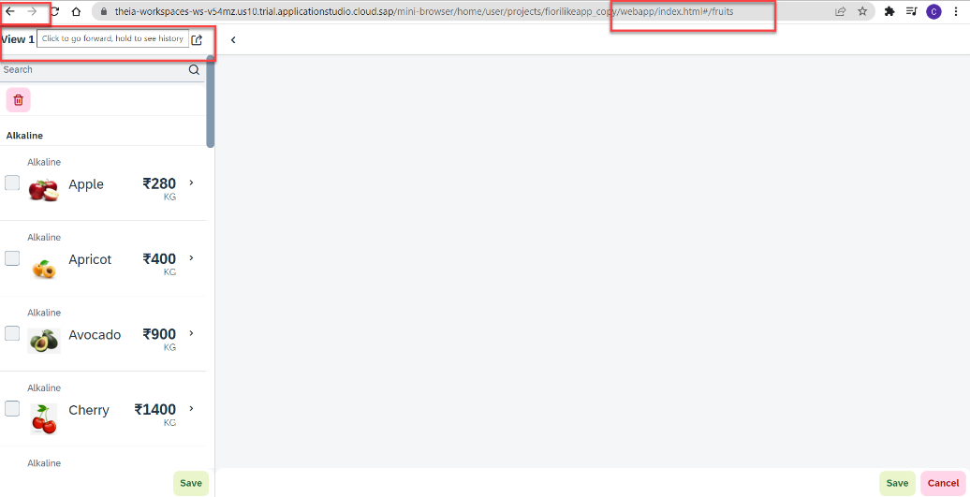
Hands – on: Routing Implementation
Now we need to implement routing in our existing application, for that we have to follow the Steps provided in the previous slides.
We also have to change the navigation in our View1 controller, and make it according to the Router, for that we have to get the router object in the View1 controller and then navigate to the view using the navTo() function.
To get the router object in View1 controller
this.oRouter = this.getOwnerComponent().getRouter();
To navigate to the View2
this.oRouter.navTo("loadMyV2");
Code Links:
manifest.json
Component.js
View1.controller.js

Slide 19
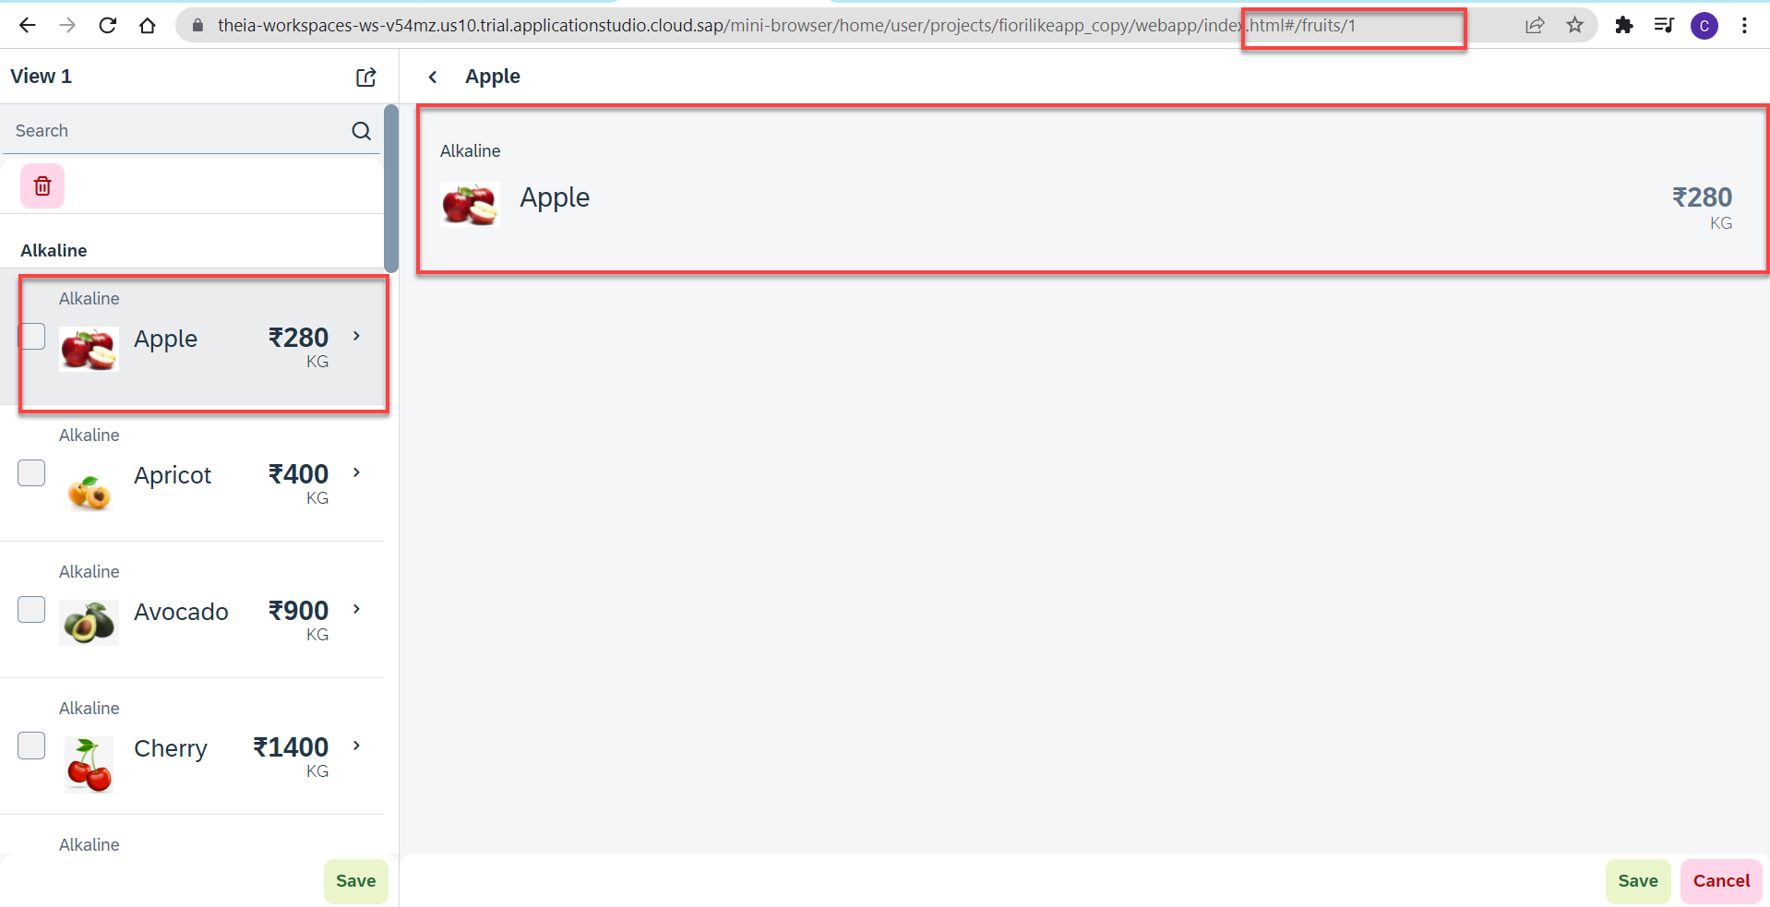
Hands – no: Route Match Handler
Route Match Handler: It is a function which gets triggered every time when Route, End Point, Hash Tag Changes.
Now using the route match handler we will load the data of the selected fruit.
Code Link:-
View1.controller.js
View2.controller.js
manifest.js

Slide 20

End of Day 9

Slide 21

Questions

Slide 22

Anubhav Oberoy

Slide 23


We’re committed to empower you to be
Most Desirable Resource
through powerful training solutions.
We build the workforce of the future.
250+
Corporate Clients
30,000+
Learners Trained
25000+
Learners Placed
FREE WEBINARS
Sign up for free webinars with industry experts every fortnight!
Enroll Now!
Contact us today!
https://anubhavtrainings.com/

Slide 24




More from AnubhavTrainings.com

Slide 25
Title
Content

